Slide 1
2024 Outstanding Leadership Award
Process for LCWR
Regional Meetings
Fall 2023

Slide 2
Purpose of the Award
The Leadership Conference of Women Religious has established the LCWR Outstanding Leadership Award (OLA) to:
Recognize and honor persons who have significantly contributed to the ministry of leadership, and
who reflect the LCWR mission.

Slide 3
Rationale
To thank leaders for their service and for the impact they have had on religious life.
To affirm the significance of collaborative leadership.
To inspire LCWR members and our partners in our own call to the ministry of leadership.
To lift up the value of religious life in our church and our world today.

Slide 4
The Mission of LCWR
The purpose of the conference shall be to promote a developing understanding and living of religious life by:
Assisting its members personally and communally to carry out more collaboratively their service of leadership in order to accomplish further the mission of Christ in today’s world.

Slide 5
The Mission of LCWR
Fostering dialogue and collaboration among religious congregations within the church and in the larger society.
Developing models for initiating and strengthening relationships with those concerned with the needs of society, thereby maximizing the potential of the conference for effecting change.

Slide 6
Criteria for the Award
The person must have significantly contributed to the ministry of leadership in a manner that reflects the mission of LCWR.
The potential recipient evidences:
Commitment and collaboration in the ministry of leadership.
Faithfulness to Gospel values and mission.

Slide 7
Criteria for the Award
Creative and innovative leadership in one or more areas.
Deep listening, authenticity and responsiveness to the Spirit.
Significant contributions as a leader on the national and/or international level, particularly to congregations of women religious.

Slide 8
Question for reflection
As you read the description of the LCWR Outstanding Leadership Award in the current context of religious life, church, world, and natural creation, what do you look for in an outstanding leader?
Keep this in mind as we review the nominees for the 2024 Outstanding Leadership Award.

Slide 9
Past Awardees
Mary Luke Tobin, SL
Theresa Kane, RSM
Mary Daniel Turner, SNDdeN
Catherine Pinkerton, CSJ
Joan Chittister, OSB
Helen Maher Garvey, BVM
Sharon Holland, IHM
Carol Keehan, DC
Sandra Schneiders, IHM
Patricia Farrell, OSF
Elizabeth Johnson, CSJ
Janet Mock, CSJ
Janice Bader, CPPS
Constance FitzGerald, OCD
Anita Baird, DHM
Norma Pimentel MJ
Patricia Chappell, SNDdeN
Pat Murray, IBVM
Donna Markham, OP

Slide 10
Recommendations: Nominees for LCWR Outstanding Leadership Award 2024
Marcia Allen, CSJ
Nancy Schreck, OSF
Nancy Sylvester, IHM

Slide 11
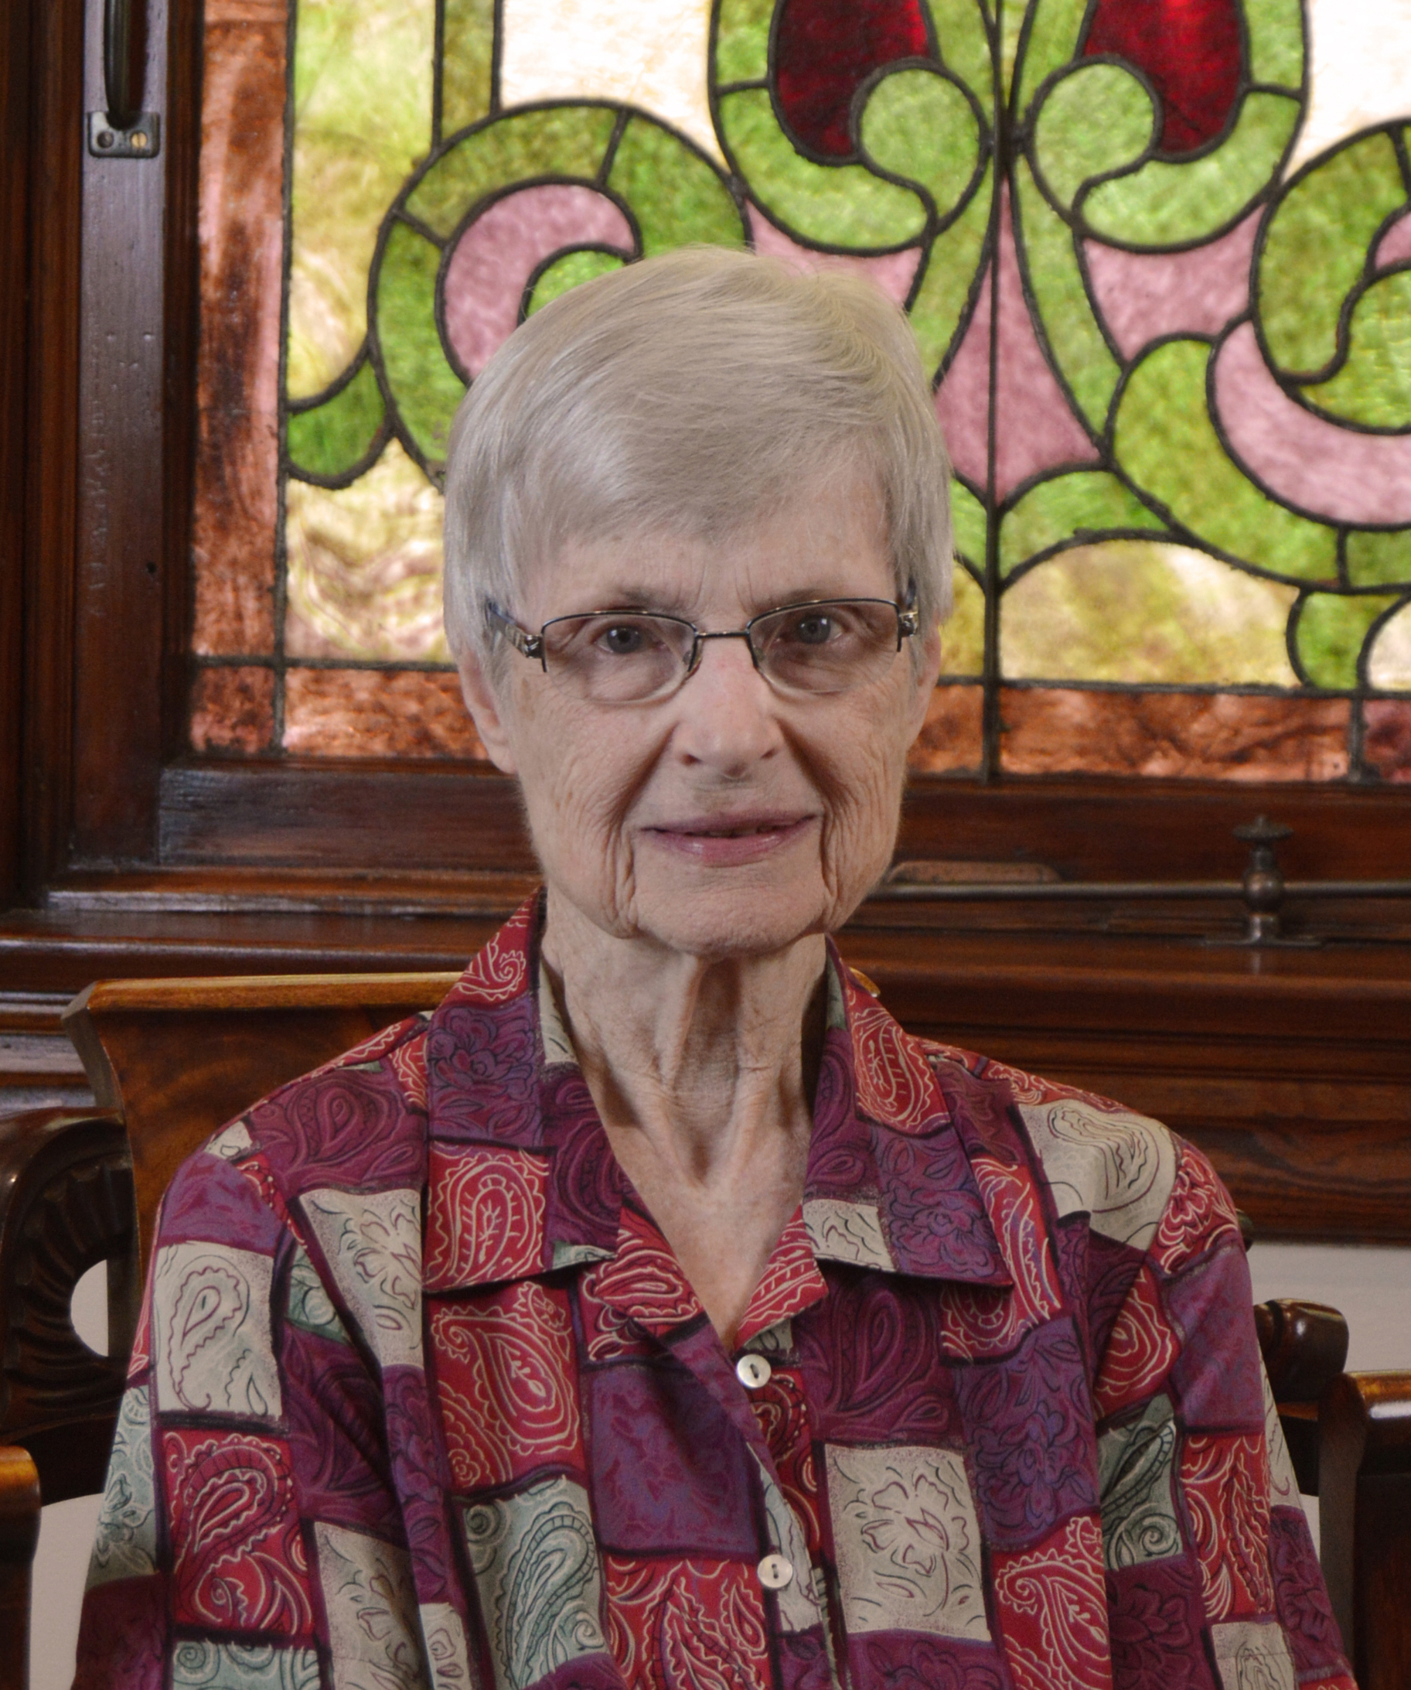
Marcia Allen, CSJ Sisters of Saint Joseph of Concordia, KS
Facilitator, retreat director and consultant to communities of women religious in the United States, Canada, India, Japan, and Brazil.
Since 1995 has served on the staff of the Manna House of Prayer leading retreats, designing programs, and providing spiritual direction.
Has designed and led retreats and workshops for leaders of women’s and men’s communities as well as for team leaders and staff of various lay groups.
Vice President (1979-1995) and President of her congregation (2008 – 2016)
LCWR Presidency (2014-2017)

Slide 12
Marcia Allen – What the region nominations noted…
“An LCWR president who challenged us to clearly discern the future of religious life and changes within LCWR.”
This Photo by Unknown Author is licensed under CC BY-NC

Slide 13
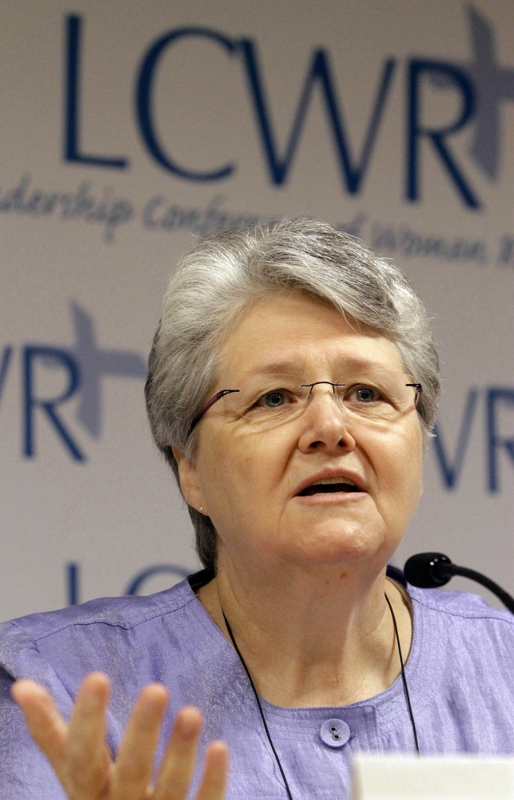
Nancy Schreck, OSF Sisters of Saint Francis, Dubuque, IA
Founder, developer and current program director of Excel, Inc., a nonprofit service agency in Okolona, Mississippi, which promotes education, welfare and community involvement for adults and children.
Has worked extensively with congregations on ecology and social justice issues and presented widely on scripture and on religious life.
Serves on the leadership council of the Franciscan Handmaids of Mary in Harlem, NY.
Vice-president (1992 – 2000) and president (2008 – 2014) of her congregation.
LCWR Presidency (1994 – 1996).

Slide 14
Nancy Schreck – What the region nominations noted…
“Leadership at a critical time in LCWR.”
“Walks the walk of service to and with the poor.”
“Speaking words of vision and hope for our time.”
This Photo by Unknown Author is licensed under CC BY-NC

Slide 15
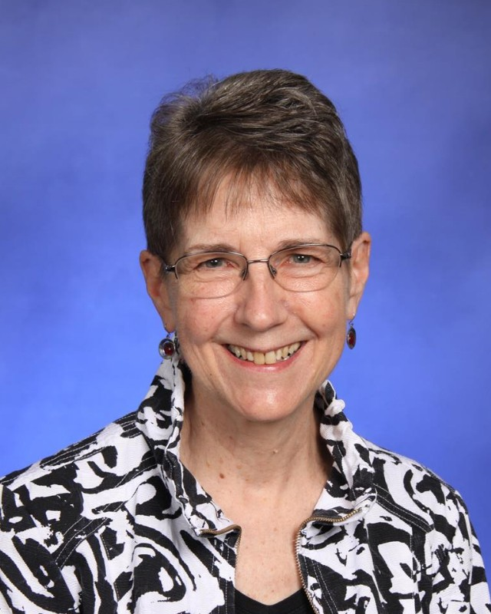
Nancy Sylvester, IHM Sisters of the Immaculate Heart of Mary, Monroe, MI
Founded the Institute for Communal Contemplation and Dialogue (ICCD). The institute organizes people of faith to reflect, analyze and act on critical issues of church and society through a process of contemplation and dialogue.
Author and speaker who has lectured widely on a variety of topics including contemplation, transformation of consciousness, and living in a time of chaos.
Has served numerous congregations by designing processes to deepen both individual and congregational commitments to contemplation, and to invite deepening conversations on the issues facing them.
Vice president of her community (1994 - 2000).
LCWR Presidency (1999 – 2001).

Slide 16
Nancy Sylvester – What the region nominations noted…
“Work with contemplative dialogue and engaging impasse”
“Commitment to the transformation of leadership
of women religious.”
“Her long work in transformation of consciousness.”
This Photo by Unknown Author is licensed under CC BY-NC

Slide 17
Table Process
Invite each person to share her first, second, and third choice nominee and give reasons why.
Note: you may name any additional persons to the list of potential recipients if you prefer.
After all have shared, move into a moment of quiet.
Then ask: What have we heard among us? Discern as a small group your first, second and third choices for the 2024 LCWR Outstanding Leadership Award.
Ask one Listener/Reporter to share a report to be given to the total group.

Slide 18
Outstanding Leadership Award Committee
Vicky Larson, PBVM
Constance Phelps, SCL
Sharlet Wagner, CSC
Anne Munley, IHM
Rose Marie Jasinski, CBS
Anna Marie Espinosa, IWBS

